Slide 1
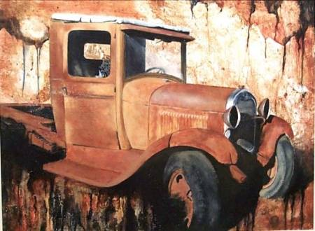
Rusting
&
Corrosion

Slide 2
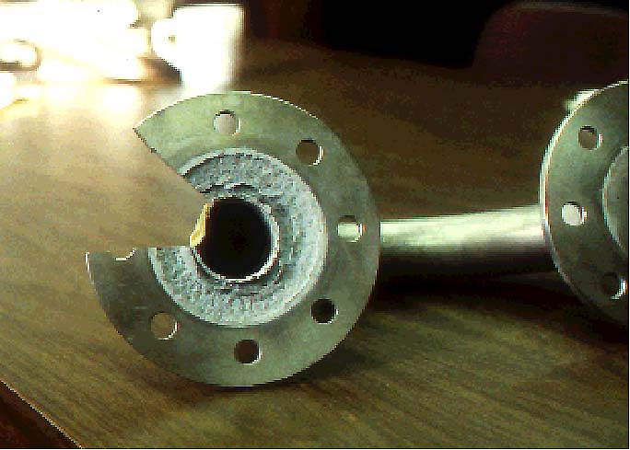
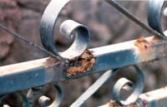
Corrosion involves the oxidation of metals.
xM_{(s)} + ^{y}/₂O_{2(g)}  M_{x}O_{y(s)}
When exposed to the atmosphere most metals form an impervious oxide layer which then protects the metal from further oxidation.
This is why aluminium is so stable even though it is a reactive metal.
This is not the case for iron (& steel) as iron oxide is porous.

Slide 3
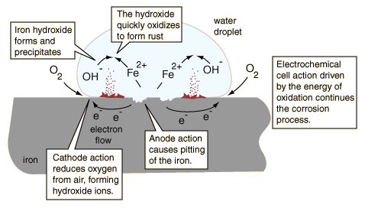
Corrosion of Iron
The iron surface acts as the anode for the process (1)
Fe_{(s)}  + Fe²⁺(aq) + 2e⁻
The electrons can move through the metallic iron to the outside of the water where
O_{2(g)} + 2H₂O_{(l)} + 4e-  4OH-_{(aq)} (2)
(1)
(2)
…ctd

Slide 4
Corrosion of Iron…ctd
Within the water, the hydroxide ions can move inward to react with the iron(II) ions moving from the oxidation region. Iron(II) hydroxide is precipitated. (3)
Fe2+_{(aq)} + 2OH-_{(aq)}  Fe(OH)_{2(s)}
Rust is then quickly produced by the oxidation of the precipitate.
4Fe(OH)_{2(s)} + O_{2(g)}  2Fe₂O₃ •H₂O_{(s)} + 2H₂O_{(l)}
(3)

Slide 5
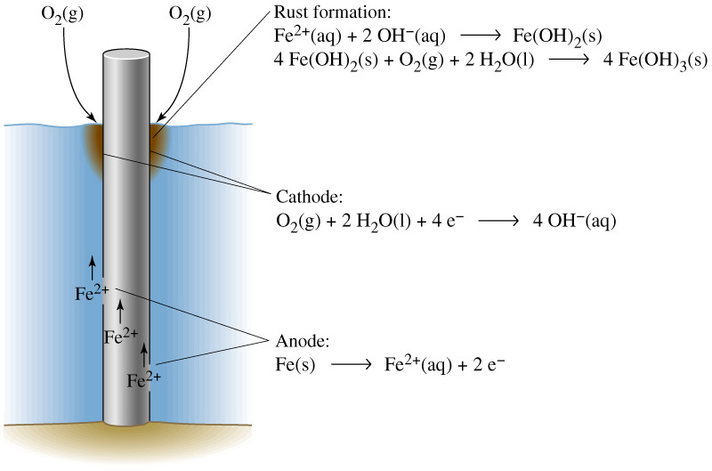
Corrosion of Submerged Steel Pole
Similar processes occur as in the previous example.
However, corrosion is concentrated at the surface where there is more oxygen.

Slide 6
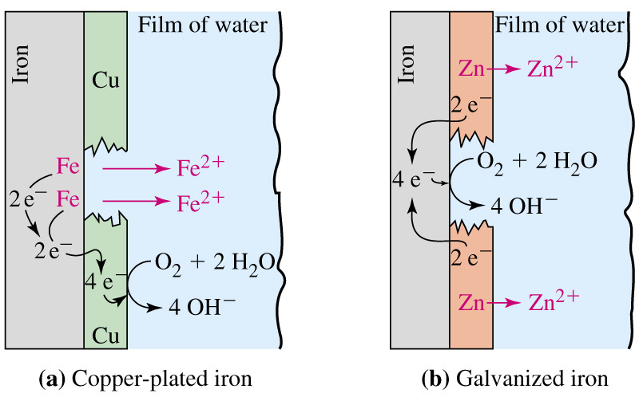
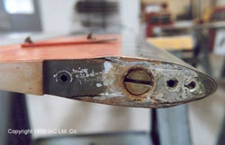
Rusting in the Presence of Other Metals
If two metals are joined where moisture is present, an electrochemical cell is formed and the corrosion of the more reactive metal is accelerated. In the example to the left, the less reactive copper acts as cathode (and stays reduced) while the iron is anodic (& is oxidised).
An aluminium helicopter blade has corroded near where it was in contact with a steel counterbalance.

Slide 7
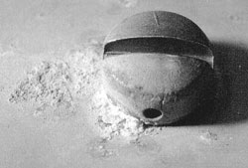
Rusting in the Presence of Other Metals
…ctd
This photo shows the corrosion caused by a stainless steel screw causing galvanic corrosion of aluminium.

Slide 8
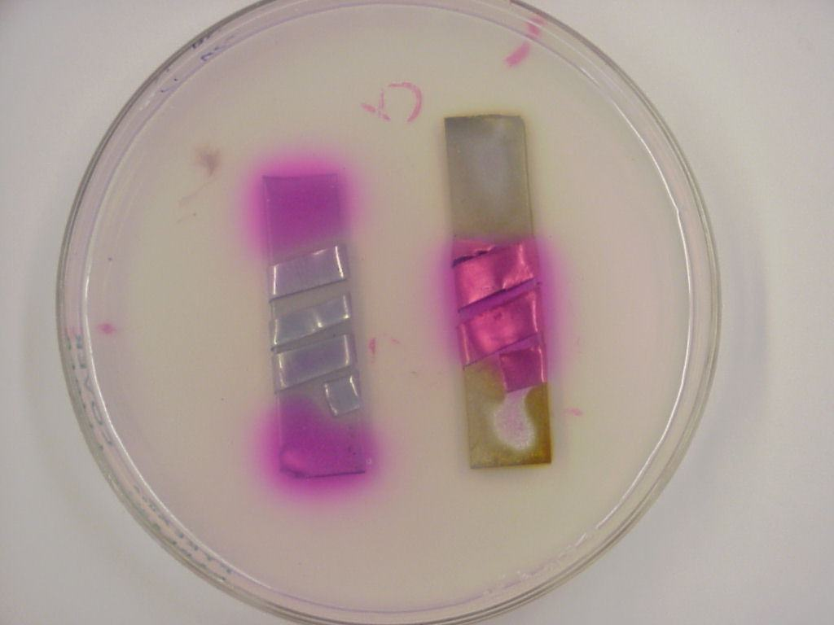
Rusting in the Presence of Other Metals …ctd
Experiment : Using Phenolphthalein as indicator, iron wrapped in zinc is on the left and iron wrapped in copper is on the right.

Slide 9
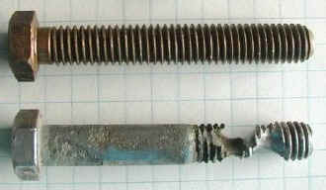
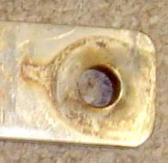
Crevice Rusting
Crevice corrosion is a localized form of corrosion usually associated with areas of limited aeration which become anodic. Such environments include those formed under gaskets, washers, fastener heads, disbonded coatings, threads, and clamps.

Slide 10
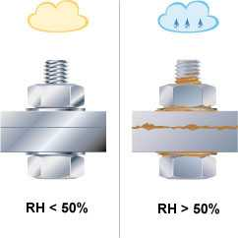
The Prevention of Rusting
Rust can be prevented or restricted in several ways.
1. Modification of the Environment – water can be removed from the environment with refridgerative air conditioning.

Slide 11
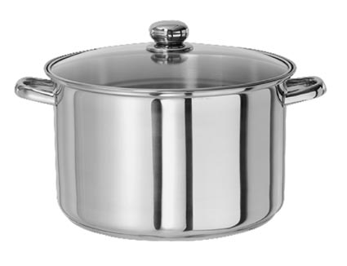
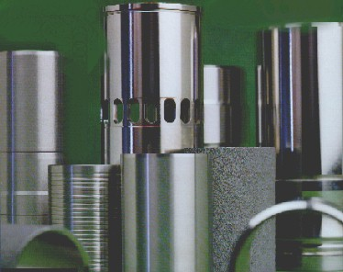
2. Modification of the Iron – alloying iron with other elements can change its properties.
Stainless steel is an alloy of iron (80%), chromium (15%), nickel (4%) and carbon (0.5 to 1%).
Stainless steel is strong and hard, with a very high resistance to corrosion (due to chromium).
It is used for cookware, cutlery and industrial chemical plant

Slide 12
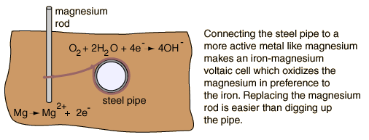
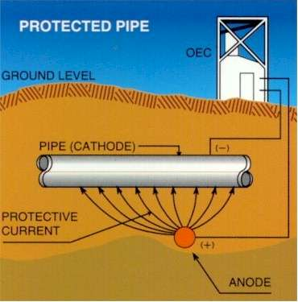
3. Cathodic Protection
If steel is made cathodic it can be protected. This can be achieved by:
(a) connecting it to a more active metal. The more active metal corrodes and is hence known as a “sacrificial anode”.
(b) giving the steel a small negative potential by connecting it a low voltage DC source. A piece of scrap can then be use as the anode.

Slide 13
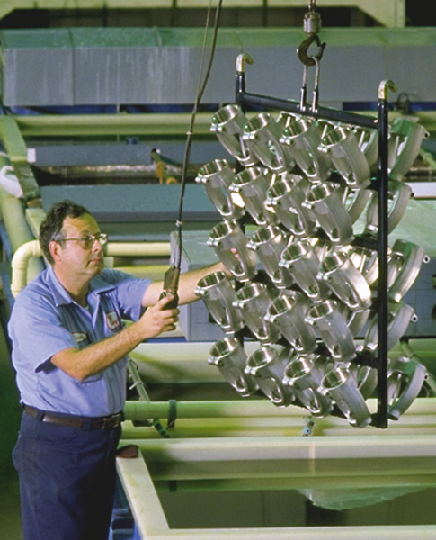
4. Protective Metallic Coatings
Many metals form a protective oxide coating. They can be used as a thin layer over steel.
Tin plate is used in food cans.
Zinc is used as a coat in galvanised iron. If the protective oxide seal is broken the zinc also acts as a sacrificial anode.
Chrome plating acts as a seal and a decorative coating.

Slide 14
Unfortunately, if the metal coating is less reactive the rusting of iron can be accelerated as an electrochemical cell is formed.
However, if the coating is more reactive it may act as a sacrificial anode in the electrochemical cell.

Slide 15
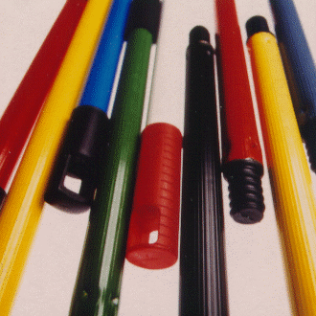
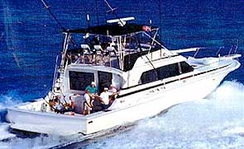
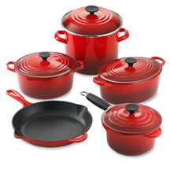
5. Protective Non- metallic Coatings
Metals can also be coated with a protective coating
Of oil, grease, paint, enamel, glass & plastics.

Slide 16
End of Slide Show
To Return to Year 12 Tutorial List
Choose Back from Menu above

